Slide 1
A Journey Into Vector Tiles
Dave Barter
dave@nautoguide.com
@citizenfishy
CEO – Nautoguide Ltd.

Slide 2
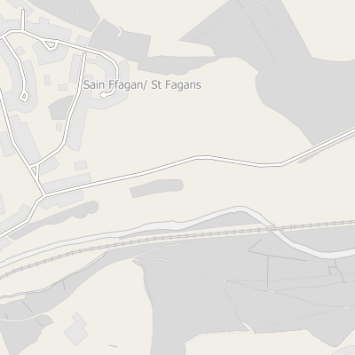
Vector Tiles
layers {
version: 2
name: "points" features: { id: 1 tags: 0 tags: 0 tags: 1 tags: 0 tags: 2 tags: 1 type: Point geometry: ... } features { id: 2 tags: 0 tags: 2 tags: 2 tags: 3 type: Point geometry: ... } keys: "hello" keys: "h" keys: "count" values: { string_value: "world" } values: { double_value: 1.23 } values: { string_value: "again" } values: { int_value: 2 } extent: 4096 }
Smaller
Client Side Styling
Faster (WebGL)
MVT Specification

Slide 3
Using Vector Tiles
Mapbox - https://www.mapbox.com/
Openlayers – https://openlayers.org/
Leaflet – https://leafletjs.com

Slide 4
Making Your Own
Grab some open data
Export as GeoJSON
Render into MVT format
Create client style

Slide 5
A Journey Into Vector Tiles
Dave Barter
dave@nautoguide.com
CEO – Nautoguide Ltd.

